Slide 1
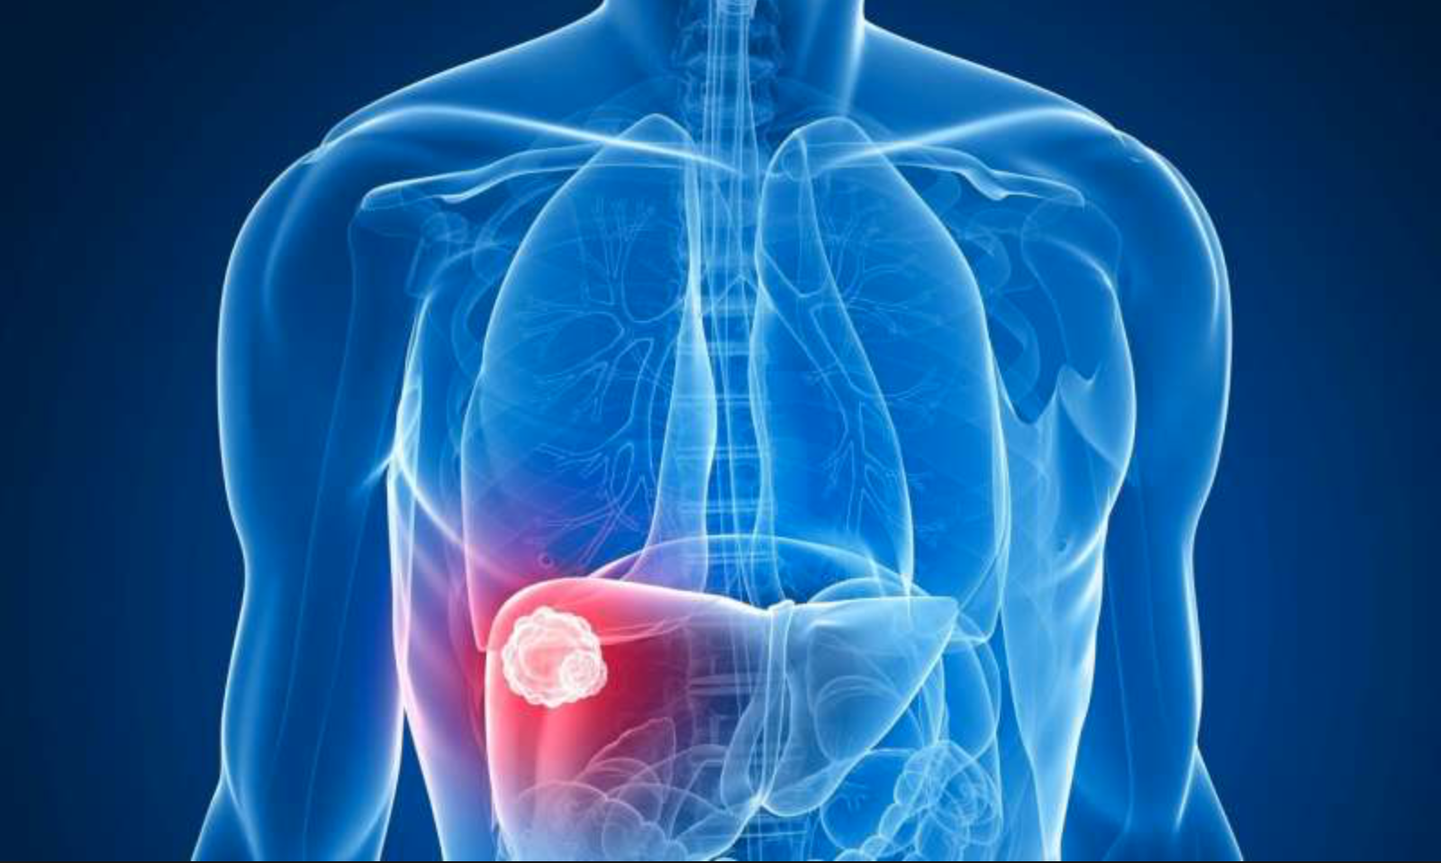
Predicting One Year Survival of Patients with Hepatocellular Carcinoma: A Logistic Regression Model
Pablo Salcedo, M.D.

Slide 2
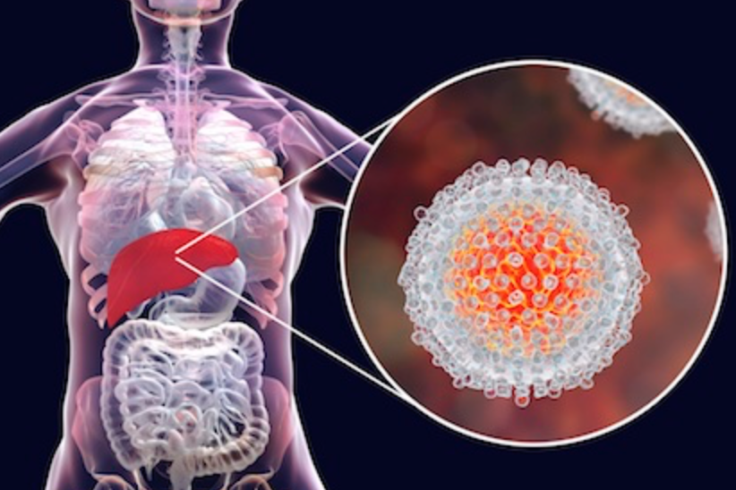
Goal
To reduce patient mortality rate secondary to hepatocellular carcinoma
through earlier initiation of intervention methods
Method
Creating a logistic regression model capable of predicting whether a patient diagnosed with hepatocellular carcinoma will survive past one year
Audience
Clinicians, patients, and policy makers
Notes:
Goal: The purpose of this model, in predicting whether a patient diagnosed with hepatocellular carcinoma will survive past one year in conjunction with established guidelines, is to reduce mortality rate secondary to hepatocellular carcinoma.
This logistic regression model would prove most useful to clinicians, patients, and policy makers alike—as they grapple with the cancer decision making process and potential treatment options. Ideally, machine learning and statistical models will find a place in depicting a completer and more holistic predictive patient profile.

Slide 3
Liver Cancer: the Relevance Today
Notes:
One out of every six deaths that occur in the world are due to cancer. Cancer is second only to cardiovascular disease in all-cause mortality globally. Liver cancer (hepatocellular carcinoma) is consistently ranked as one of the most common forms of cancer and is one of the most lethal (Figure 1), with a 5-year survival rate of about 15% in the USA (Figure 2).
Estimated that 30,000 Americans will die from liver cancer this year.

Slide 4
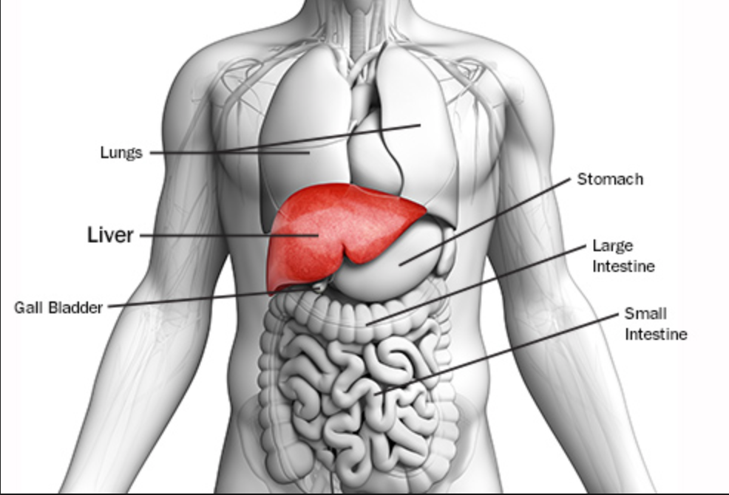
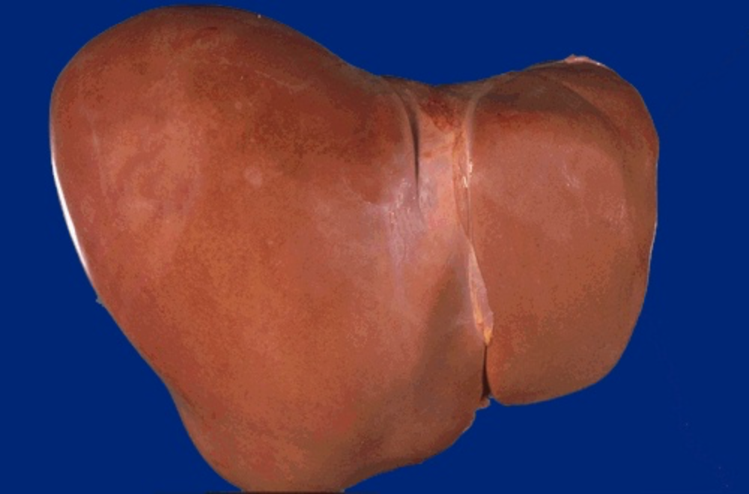
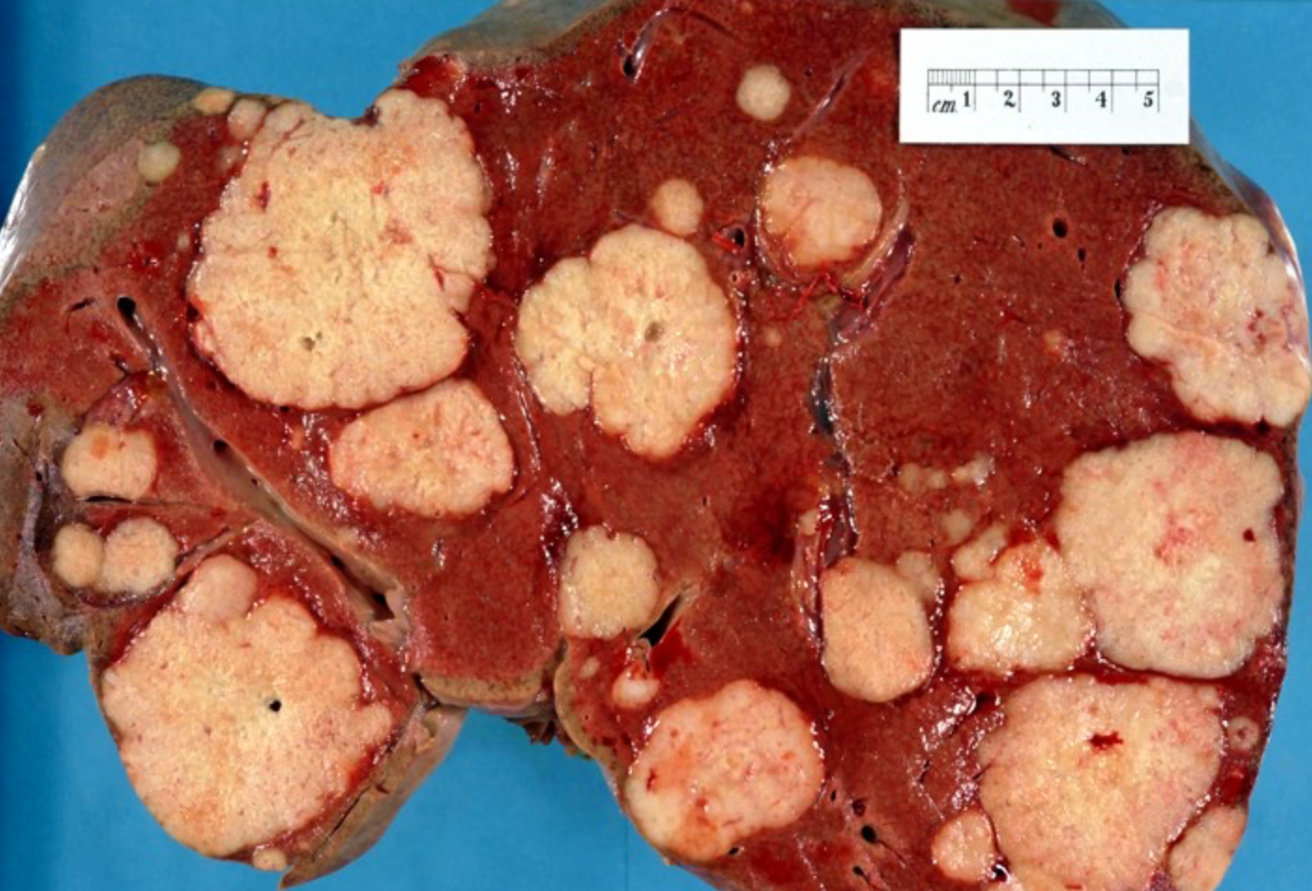
Hepatocellular Carcinoma (Liver Cancer)
Notes:
The liver is a football sized organ nestled under the diaphragm in the URQ.
The most common type of liver cancer is hepatocellular carcinoma, which begins in the main type of liver cell (hepatocyte)
Most people don't have signs and symptoms in the early stages of primary liver cancer. When signs and symptoms do appear, they may include:
Losing weight without trying
Loss of appetite
Upper abdominal pain
Nausea and vomiting
General weakness and fatigue
Abdominal swelling
Yellow discoloration of your skin and the whites of your eyes (jaundice)
White, chalky stools

Slide 5
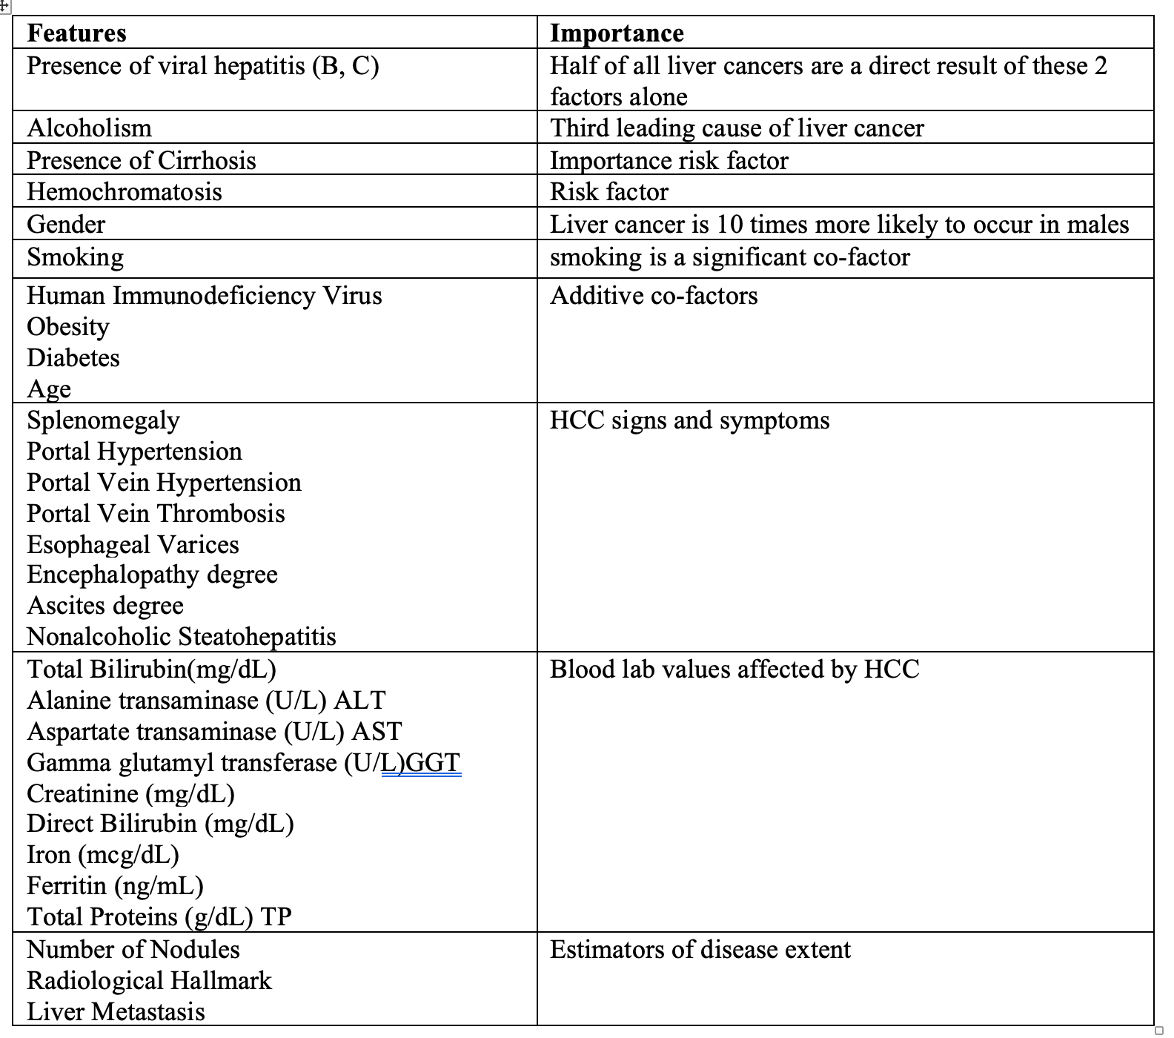
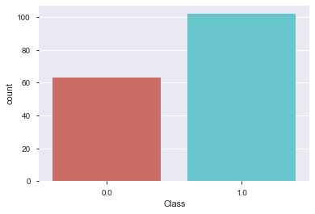
Data Summary
Left: Features Summary
Below: Target Class Distribution
Notes:
This hepatocellular carcinoma dataset consists of patient data from 165 former patients of Hospital and University Centre of Coimbra (Portugal). The dataset contains 49 features selected according to the EASL-EORTC (European Association for the Study of the Liver - European Organization for Research and Treatment of Cancer) Clinical Practice Guidelines. The target variable, "Class", is the survival of each patient at 1 year and is represented as 0 (deceased) and 1 (alive).
Many of the features for which patient data was collected are important risk factors for the development of HCC. In the table below some of the key features included in the model are detailed.

Slide 6
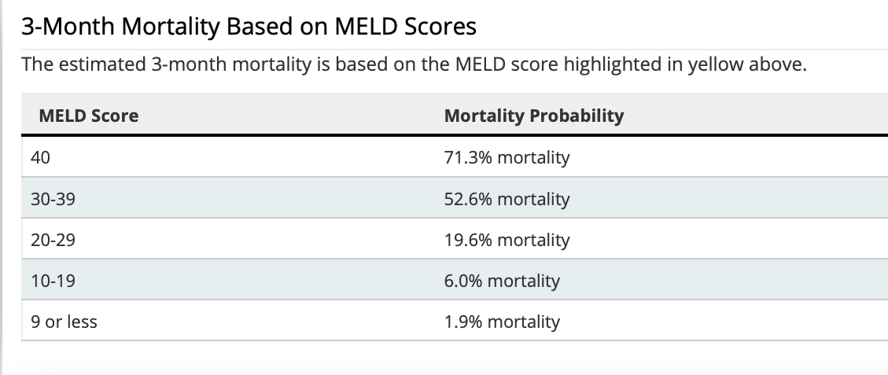
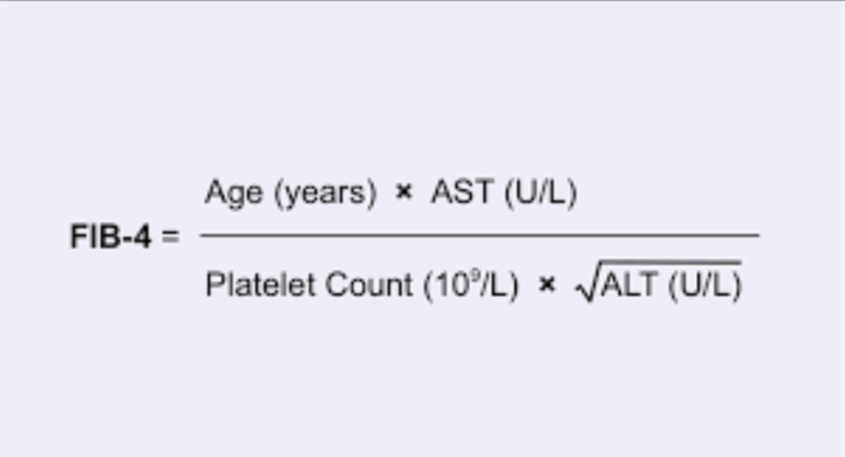
Optimizing model performance
K- nearest neighbor
Notes:
Prior to running the logistic model, gender was binarized into male and female and two additional features were created. The first engineered feature is that of a MELD score. The Model for End-Stage Liver Disease Score (MELD) is a widely used clinical scoring method to predict 3 month mortality rates in patients with end-stage liver disease. It stratifies severity of end-stage liver disease for transplant planning. The second feature created was a Fibrosis-4 Index (FIB-4) score. The FIB-4 Index score is a noninvasive estimate of liver scarring in HCV and HBV patients. Together these 2 features contributed an approximate 3% improvement to the model's overall predictive ability.
A unique aspect of healthcare data in general, is the "patient profile" that is created when a broad amount of data is collected for each unique patient. In order to preserve the heterogeneity of the patient profile and provide a more accurate estimation of missing patient values, missing values were imputed via a K-nearest neighbor (KNN) model. The most similar of the 3 closest patient records was utilized to fill in the corresponding missing values in question.
In order to address the class imbalance (greater number of living patients at 1 year than deceased) inherit to the HCC dataset, SMOTE (Synthetic Minority Over-sampling Technique) was utilized. Prior to smote, the training data consisted of 115 patient records, after SMOTE, 146 patient records were available for model training use.
Finally, a grid search was utilized to optimize parameters and assign most appropriate penalty weights prior to running the logistic model.

Slide 7
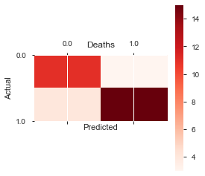
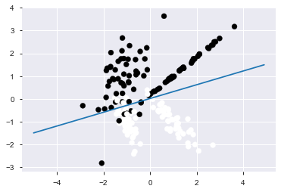
Results
Figure B: Decision Boundary Graph
Figure A: Confusion Matrix
Area Under Curve (AUC): 0.83
Accuracy: 0.82
Testing F1-Score: 0.83
False Positive Rate: 0.14
0 1
----- -----
0 | TN | FP
----- -----
1 | FN | TP

Slide 8
Discussion
Notes:
In order to capture the heterogeneity for each patient profile, as well as the dataset class imbalance, clustering oversampling techniques were utilized. The final model used was a logistic regression model, as it provided higher predictive value compared to other models such as Support Vector Machine (SVM) and Random Rorest Ensemble.
The performance of the logistic model was assessed by utilizing the performance measures of accuracy, AUC, and F-1 score. Particular attention was given to minimizing the false positive rate, as the threshold for incorrectly predicting that a patient would live at least 1 more year (Class=1) is minimal.
The logistic regression model returned an accuracy of 82%, an AUC of 83%, and a F-1 score of 83% on the testing dataset. The false positive rate was calculated to be 14%. All performance measures improved with the use of KNN (K-nearest Neighbor) to impute missing patient data as well as with the addition of the SMOTE oversampling technique to address class imbalance and the creation of two additional features MELD score and FIB-1 Index score.
By providing a convenient and quickly accessible HCC diagnostic tool, this model can serve as a supplement in patient decision making. By combining machine learning’s ability to analyze large datasets in minimal time with decision makers’ context knowledge, more robust and efficient clinical decisions can be made earlier in the disease lifecycle resulting in better clinical outcomes.
Areas of future work include training predictive models on larger patient datasets—a task easier said than done in the realm of healthcare. Furthermore, applying this model to other disease classification scenarios has the potential to positively impact how decision makers approach diagnoses and optimal treatment options. The concept of utilizing clustering techniques to fill in missing data for patients may prove promising for future healthcare models that aim to preserve patient profile heterogeneity.
The majority of liver cancer cases are detected at advanced stages of disease, when treatment options are severely limited in both quantity and effectiveness. With this in mind, more effective screening and earlier cancer detection has the most potential to save lives and reduce disease cost burden. A better understanding of hepatocellular carcinoma and its risk factors is necessary for more effective screening, early recognition, and optimal treatment.
Localized treatment options include radiofrequency ablation, cryoablation, chemoembolization,
Surgical treatment options include surgical resection and liver transplant
Chemotherapy, radiotherapy, immunotherapy, and targeted drug therapy are other options
Surgery to remove the tumor. In certain situations, your doctor may recommend an operation to remove the liver cancer and a small portion of healthy liver tissue that surrounds it if your tumor is small and your liver function is good.
Whether this is an option for you also depends on the location of your cancer within the liver, how well your liver functions and your overall health.
Liver transplant surgery. During liver transplant surgery, your diseased liver is removed and replaced with a healthy liver from a donor. Liver transplant surgery is only an option for a small percentage of people with early-stage liver cancer.
Localized treatments
Localized treatments for liver cancer are those that are administered directly to the cancer cells or the area surrounding the cancer cells. Localized treatment options for liver cancer include:
Heating cancer cells. Radiofrequency ablation uses electric current to heat and destroy cancer cells. Using an imaging test as a guide, such as ultrasound, the doctor inserts one or more thin needles into small incisions in your abdomen. When the needles reach the tumor, they're heated with an electric current, destroying the cancer cells. Other procedures to heat the cancer cells might use microwaves or lasers.
Freezing cancer cells. Cryoablation uses extreme cold to destroy cancer cells. During the procedure, your doctor places an instrument (cryoprobe) containing liquid nitrogen directly onto liver tumors. Ultrasound images are used to guide the cryoprobe and monitor the freezing of the cells.
Injecting alcohol into the tumor. During alcohol injection, pure alcohol is injected directly into tumors, either through the skin or during an operation. Alcohol causes the tumor cells to die.
Injecting chemotherapy drugs into the liver. Chemoembolization is a type of chemotherapy treatment that supplies strong anti-cancer drugs directly to the liver.
Placing beads filled with radiation in the liver. Tiny spheres that contain radiation may be placed directly in the liver where they can deliver radiation directly to the tumor.
Radiation therapy
This treatment uses high-powered energy from sources such as X-rays and protons to destroy cancer cells and shrink tumors. Doctors carefully direct the energy to the liver, while sparing the surrounding healthy tissue.
Radiation therapy might be an option if other treatments aren't possible or if they haven't helped. For advanced liver cancer, radiation therapy might help control symptoms.
During external beam radiation therapy treatment, you lie on a table and a machine directs the energy beams at a precise point on your body.
A specialized type of radiation therapy, called stereotactic body radiotherapy, involves focusing many beams of radiation simultaneously at one point in your body.
Targeted drug therapy
Targeted drug treatments focus on specific abnormalities present within cancer cells. By blocking these abnormalities, targeted drug treatments can cause cancer cells to die.
Many targeted drugs are available for treating advanced liver cancer.
Some targeted therapies only work in people whose cancer cells have certain genetic mutations. Your cancer cells may be tested in a laboratory to see if these drugs might help you.
Immunotherapy
Immunotherapy uses your immune system to fight cancer. Your body's disease-fighting immune system may not attack your cancer because the cancer cells produce proteins that blind the immune system cells. Immunotherapy works by interfering with that process.
Immunotherapy treatments are generally reserved for people with advanced liver cancer.
Chemotherapy
Chemotherapy uses drugs to kill rapidly growing cells, including cancer cells. Chemotherapy can be administered through a vein in your arm, in pill form or both.
Chemotherapy is sometimes used to treat advanced liver cancer.

Slide 9

References
Miriam Seoane Santos, Pedro Henriques Abreu, Pedro J Garcia-Laencina, Adelia Simao, Armando Carvalho, A new cluster-based oversampling method for improving survival prediction of hepatocellular carcinoma patients. Journal of biomedical informatics, 58, 49-59, 2015.
- "Cancer" Roser, M., Ritchie, H. 2019.'https://ourworldindata.org/cancer'
- "Liver Cancer." 2019. *Elsevier B.V.* www.sciencedirect.com/topics/medicine-and-dentistry/liver-cancer
Questions

